Slide 1

Used Car Market Analysis
How much is my car worth? Which cars are good investments?

Slide 2
Used Car Price Factors
Context: It can be difficult to identify a specific price for every vehicles depending on the mileage, trim level, and other varying features
Criteria for Success: Create a regression model for price with an error of $3000 or less per car
Scope: Identify specific models that retain value more or less than the competition
Constraints: Lack of organized vehicle reference data, imbalanced used car listings
Stakeholders: Car Dealers, Buyers, and Analysts
Data Sources: Craigslist; Edmunds, KellyBlueBook for reference car information

Slide 3
400,000 Craigslist Vehicles Listings
(Feb 2021) - Kaggle
Columns: manufacturer, model, cylinders, transmission, drive, title status, fuel type, size, type, condition, paint color, VIN, description, state, region, latitude, longitude, odometer, price
Challenges
#1: User Entered Data
Incorrect information
Identical values entered differently
‘Condition’ subjective
#2: No Sale Price
Only Listed Price
#3: Duplicate Car Listings
Unique Listings reduced to 93,301 (using VIN Identification)

Slide 4
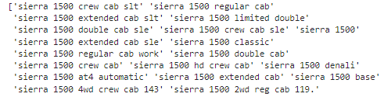
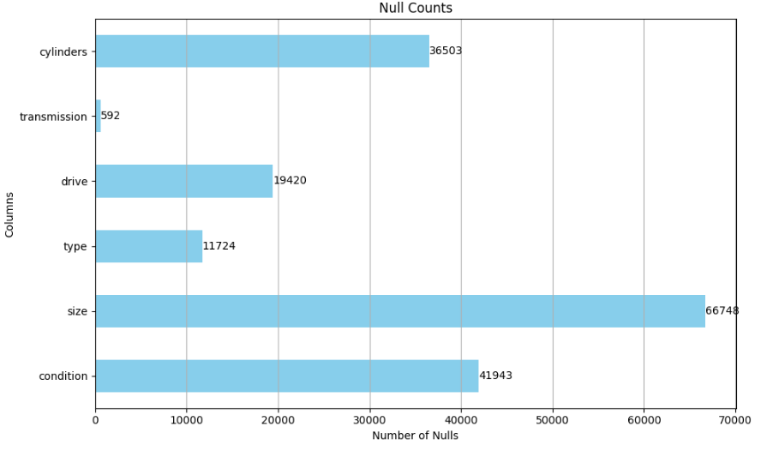
Data Quality
…113 unique values for one model

Slide 5

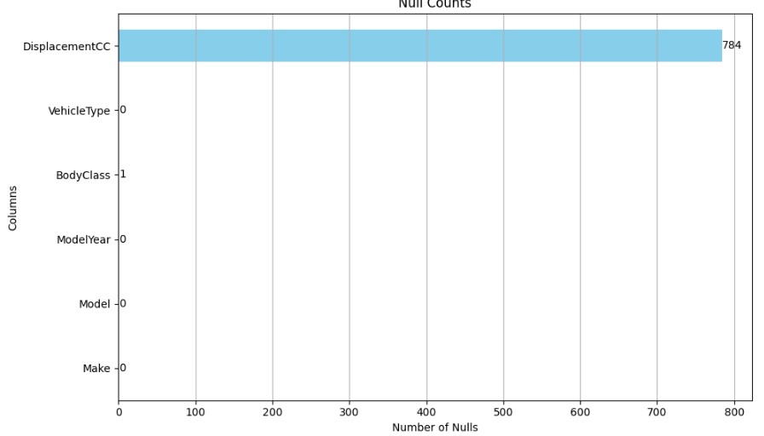
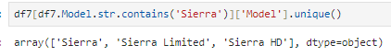
Vehicle ID: Removes Duplicates, avoiding skewed predictions/further class imbalance
Verifies Car Features:
Make
Model
Year
VehicleType
BodyClass
DisplacementCC

Slide 6
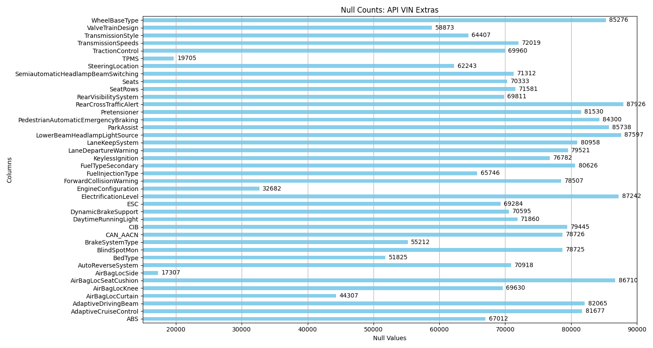

Slide 7
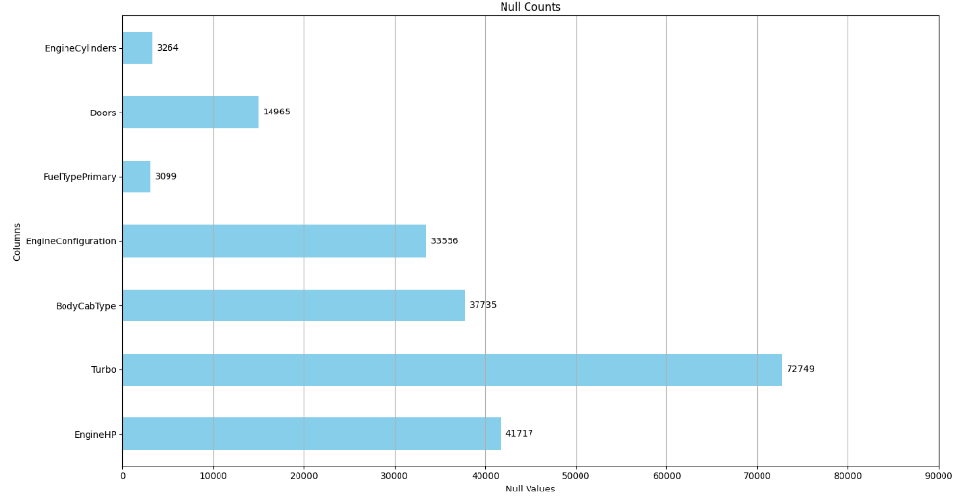
VIN Imputations
DisplacementCC: Info for imputations
BodyCabType: Missing were Non-Pickup Trucks
Doors: imputed with BodyCabType
DriveType: Imputed based on Model & DisplacementCC
Turbo: N
TransmissionSpeeds: 6
TransmissionStyle: Automatic

Slide 8
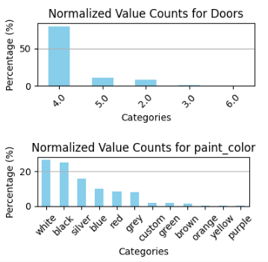
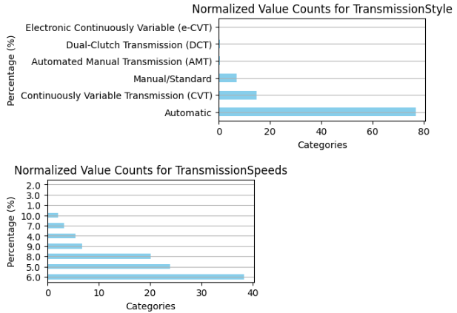
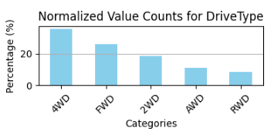
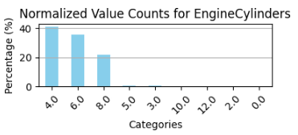
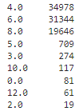
VINEDA

Slide 9
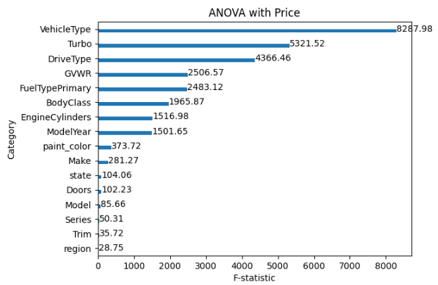

Slide 10
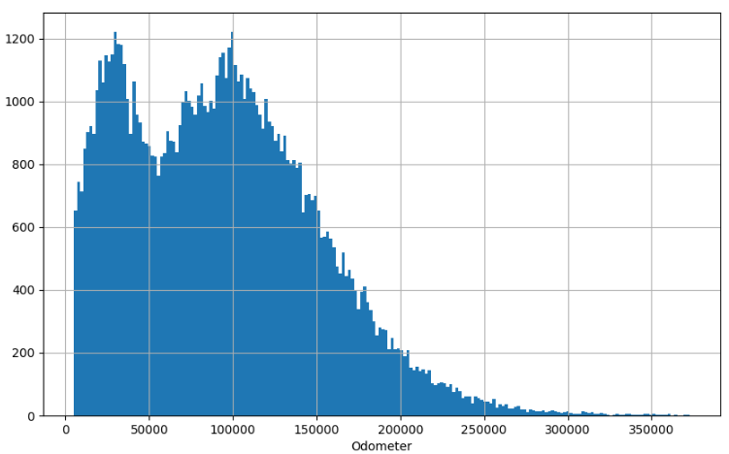
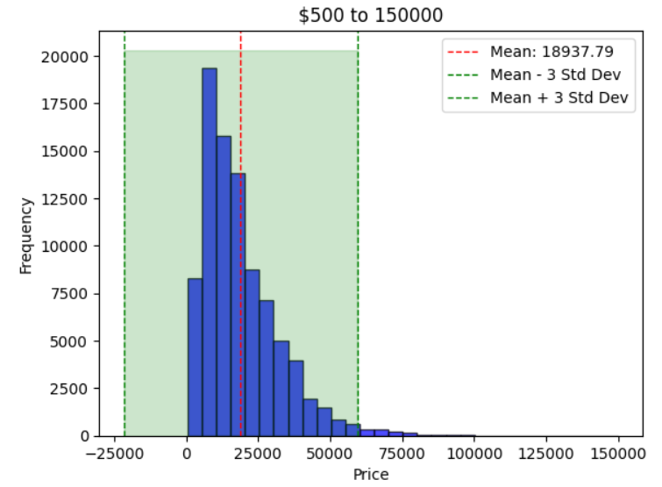
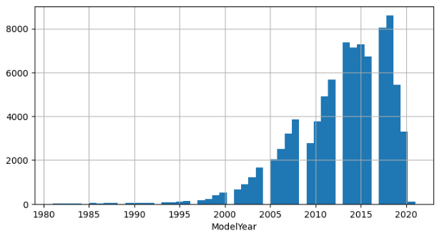
Price
Histograms
Odometer
Year

Slide 11
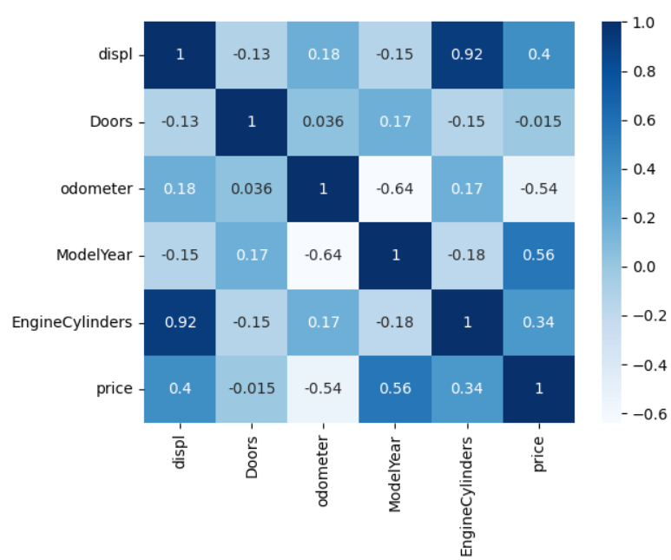
Numerical Correlations
Price
Year: 0.56 & Odometer: -0.54
Collinearity: -0.64
Displ: 0.4 & Cylinders : 0.34
Collinearity: 0.92

Slide 12
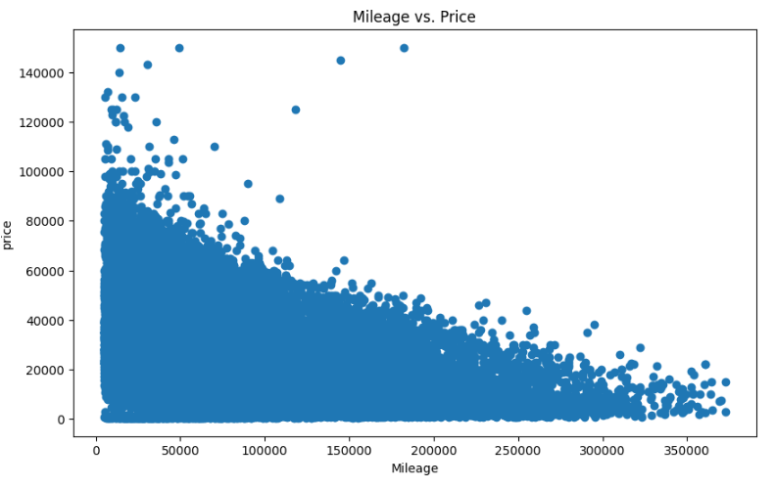
price
Scatterplots
Mileage

Slide 13
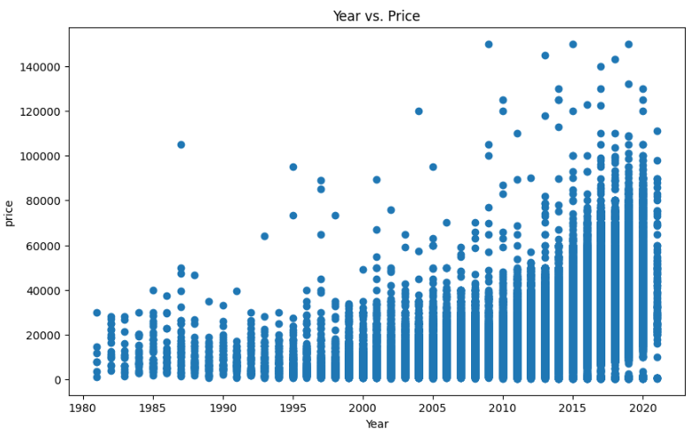
price
Scatterplots
Year

Slide 14
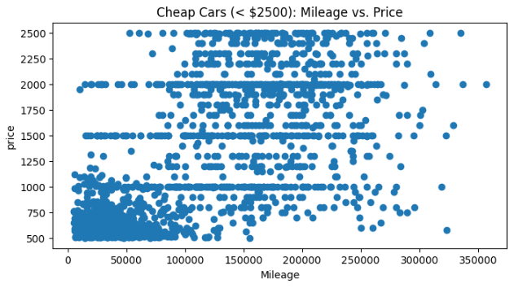
Data Problem
New Car
Low Miles
Low Price

Slide 15
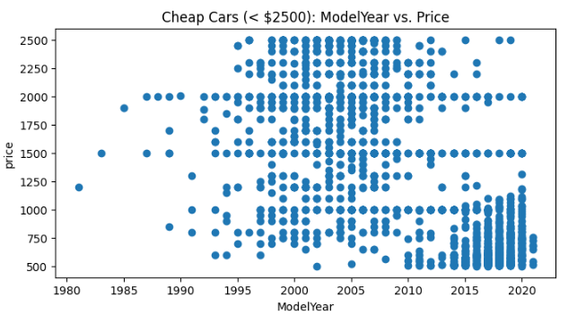
Data Problem
New Car
Low Miles
Low Price

Slide 16
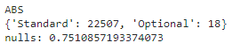
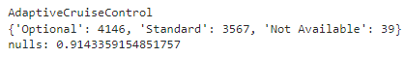
Data Problem #2
No MSRP, Series/Trim, Add-ons
2012 Dodge Challenger
Trim | MSRP
SXT 2dr Coupe (3.6L 6cyl) 305HP | $ 25,195
R/T 2dr Coupe (5.7L 8cyl) 375HP | $ 29,995
SRT8 2dr Coupe (6.4L 8cyl) 470HP | $ 44,125

Slide 17
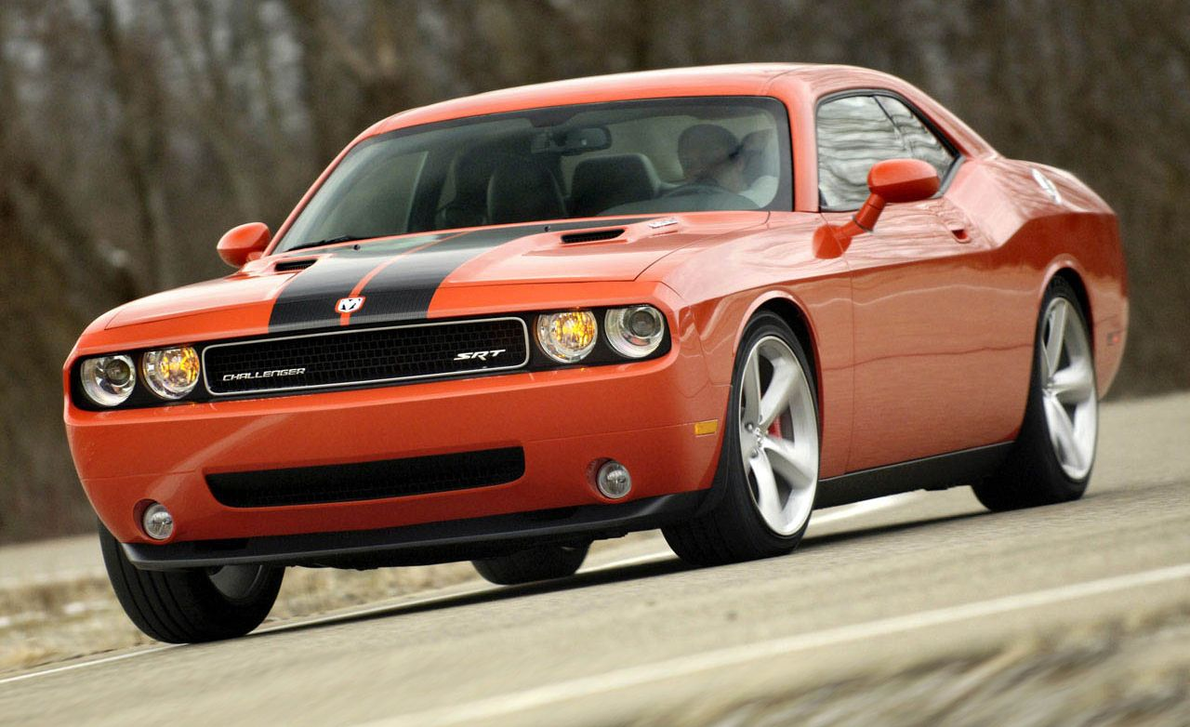
SRT-8: Worth $15,000 More?
The Dodge Challenger SRT offers many features including HID headlights and leather seats. This model is fitted with parking sensors and has 20" rims, larger than the RT version.

Slide 18
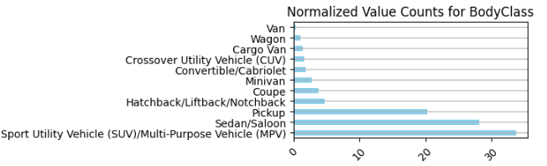
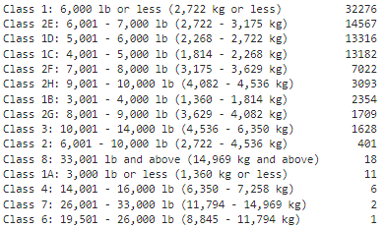
VINEDA
BodyClass
GVWR
70 Unique Makes (Chevrolet, Ford, ..)
878 Unique Models (F-150, Impala,..)
GVWR

Slide 19
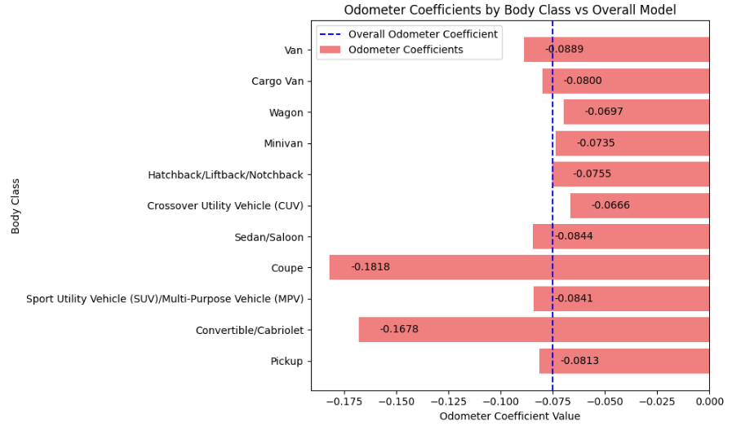
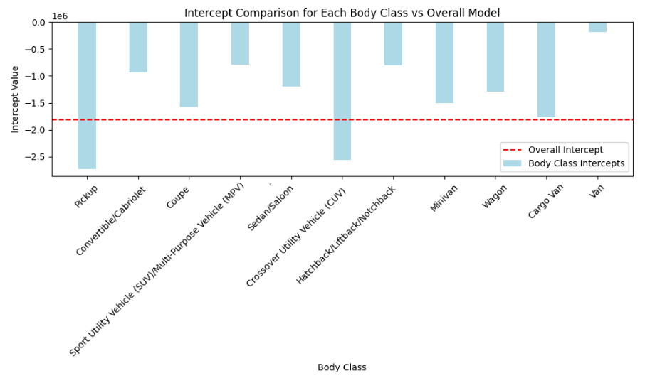
BodyClass
Rates of Depreciation
Linear Regression:
X: year, mileage
y: price

Slide 20
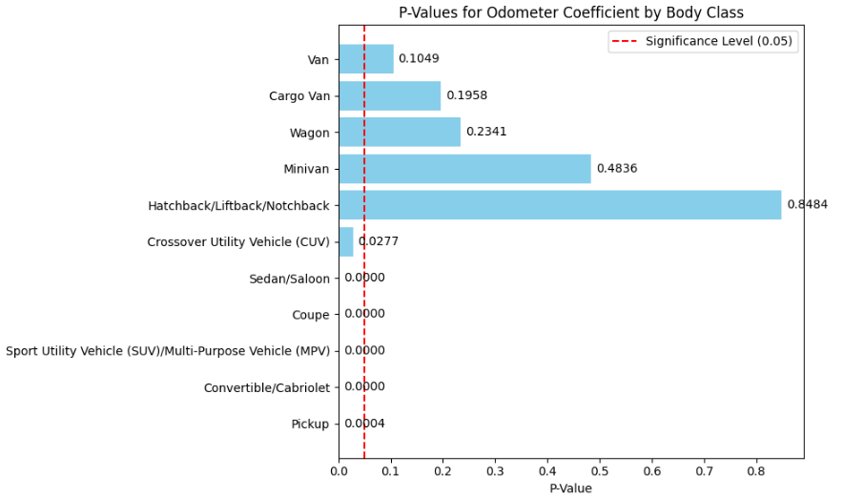
BodyClass
Rates of Depreciation
Results
Slower Depreciation Rate:
Crossover 11.2%
Faster Depreciation Rate:
Pickup: 8.4%
SUV: 12.1%
Sedan: 12.5%
Convertible: 123.7%
Coupe: 142.4%

Slide 21
‘State’ & ‘BodyClass’
Chi-Square Test:
Chi-Square Statistic: 4550.524864966057
P-Value: 0.0
Degrees of Freedom: 500 (11 BodyClass, 51 States)
Critical Value: 554.5 (0.05 Significance Value)
Reject the null hypothesis: There is a significant association between State and BodyClass.
2) Create Contingency Table
3) Create Residuals for each Cell in Contingency Table

Slide 22
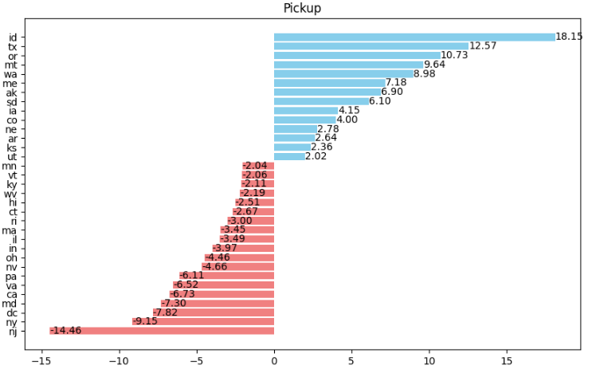
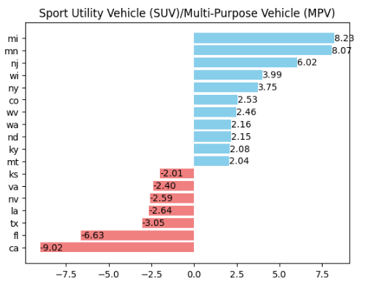
‘State’ Preferences for BodyClass: Contingency Table Residual
A residual greater than 2 or less than -2 suggests a significant deviation from independence. Positive = Higher Association, Negative = Lower Association

Slide 23
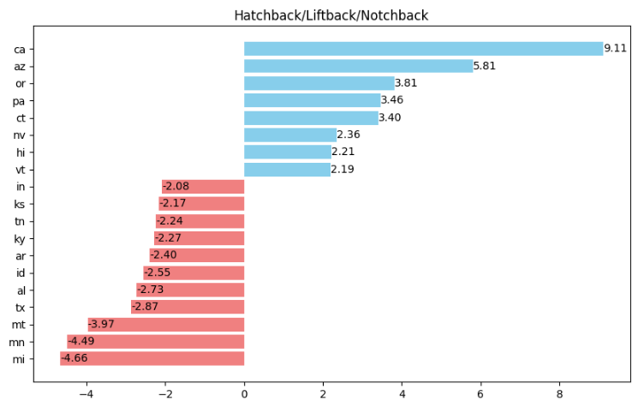
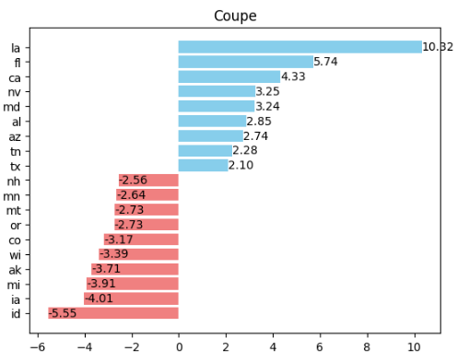
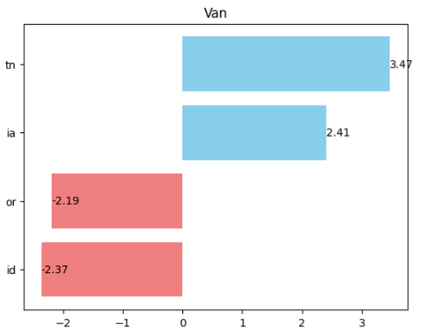
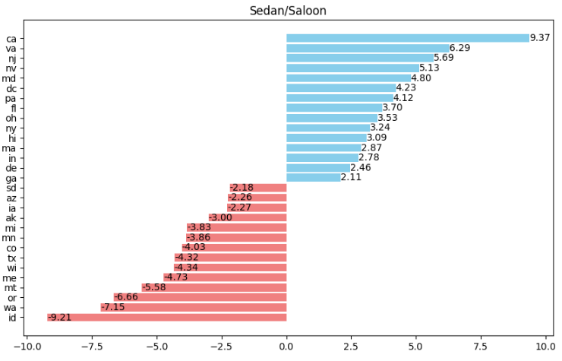
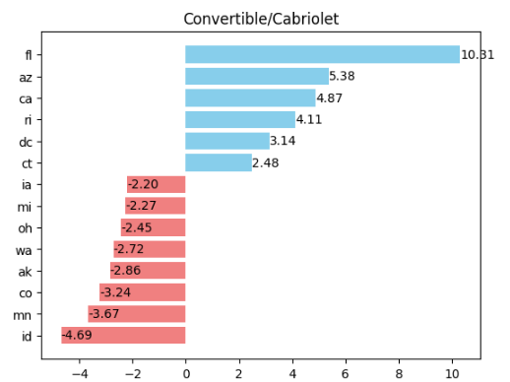

Slide 24
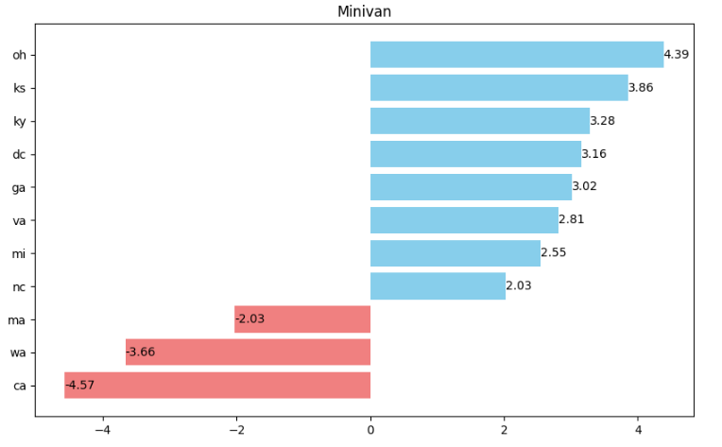
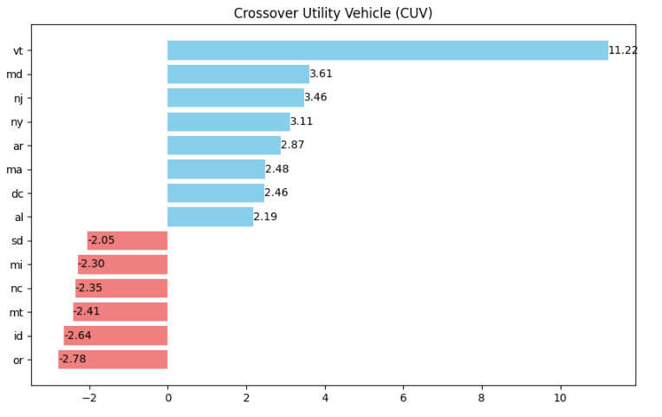
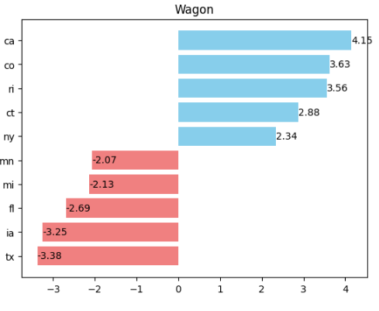

Slide 25
Price Regression
Categorical Features: Turbo, Body Class, Fuel Type, Cylinders, Vehicle Type, Drive Type, GVWR, Doors, paint_color
Numeric Features: odometer, Year, displ (StandardScaler)
Target Feature: Price
Split: Train Test Split
Search: RandomizedSearch; 2 iterations
Folds: 3
Metric: RMSE
Models: LinearRegression, Ridge, Lasso, DecisionTree, RandomForest, AdaBoost, ExtraTrees, KNNRegressor, MLPRegressor, SGDRegressor, Bagging, XGBoost, LightGBM, CatBoost

Slide 26
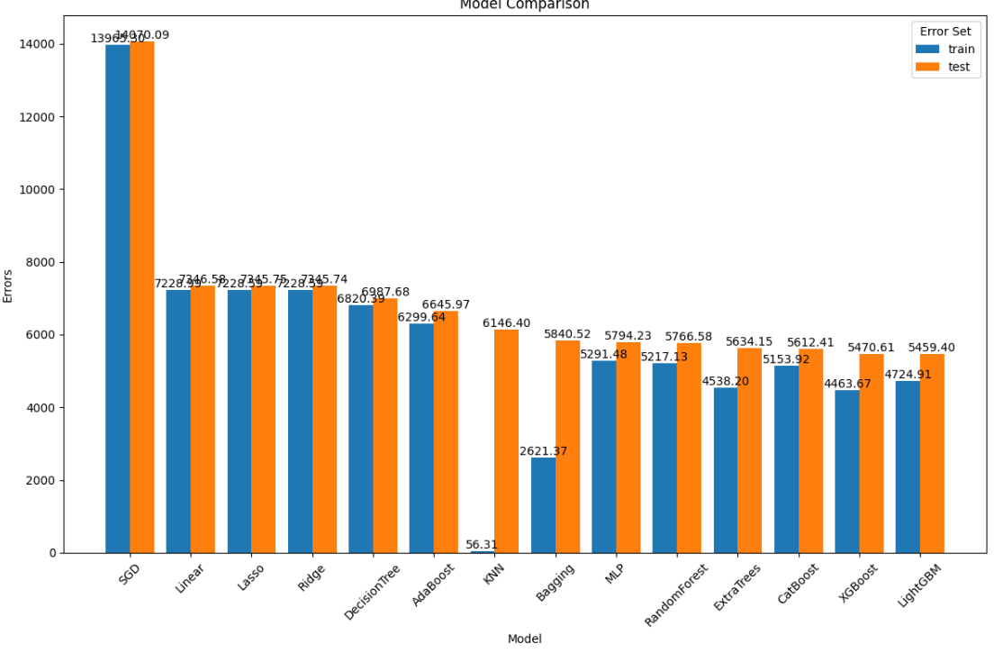

Slide 27
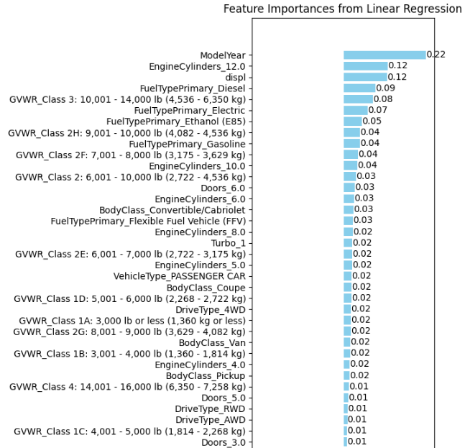
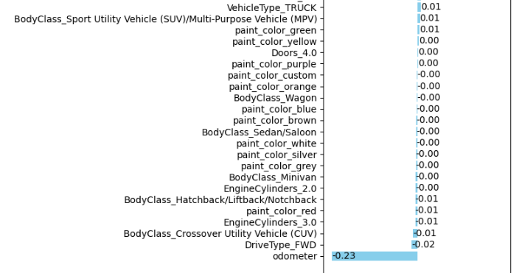
Coefficients
RMSE: $ 7,346
Intercept: -0.156418

Slide 28
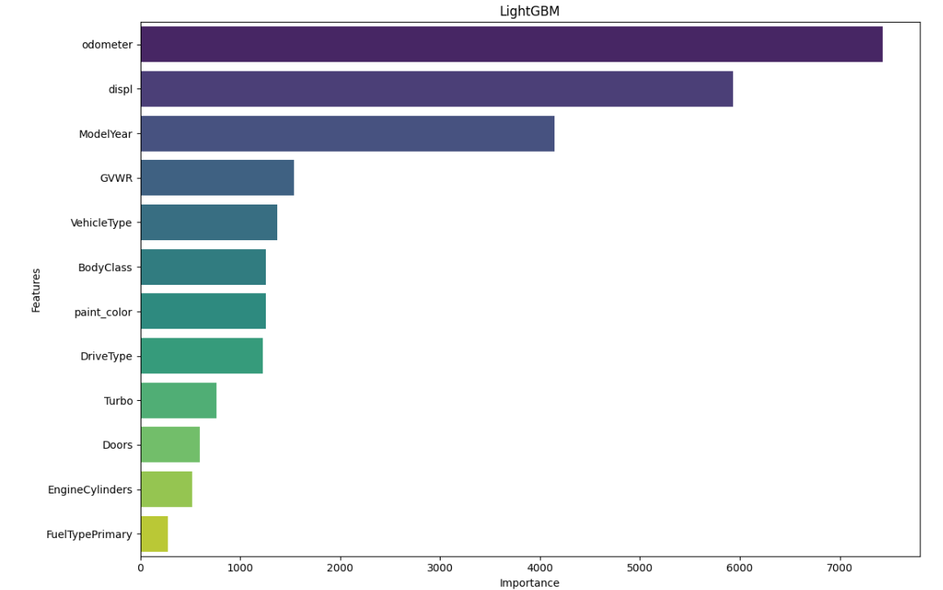

Slide 29
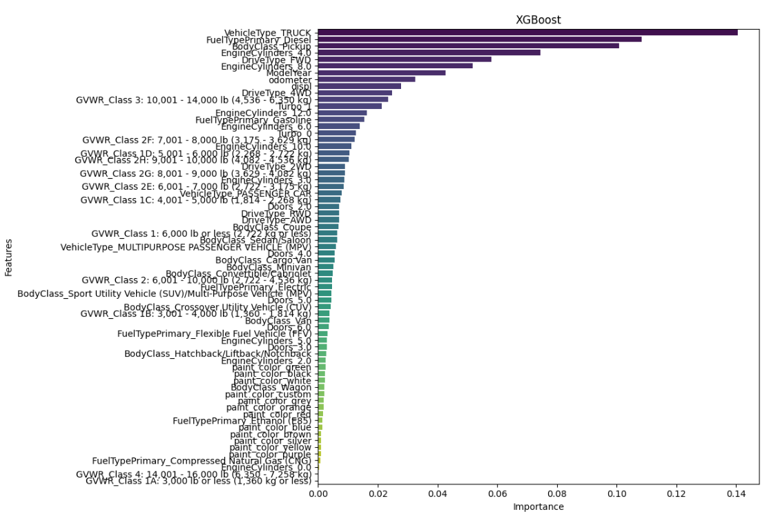

Slide 30
Final Models: Gradient Boosted Trees
XGBoost
Dummy Variables
Level-Wise Tree Building
Imputes Missing Values Automatically
Slower, More Memory
CatBoost
Avoids Overfitting while handling data with many discrete values (such as Series, Trim)
Learns Relationships between these categorical variables using their relative mean
LightGBM
Fast Training, Prone to Overfitting
Bins Continuous Variables
Can automatically bundle features that are rarely non-zero at the same time, thus reducing dimensionality and speeding up computations.

Slide 31
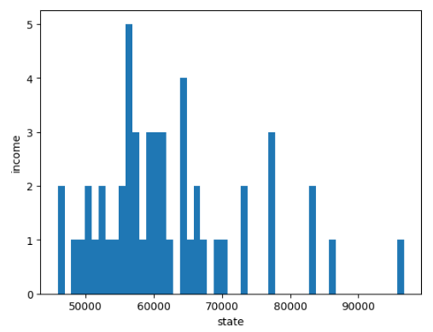
New Features
Statista: 2021 Median state Income
State, region, state_income
Make, Model, Series/Trim to find which makes and models are important to price predictions

Slide 32
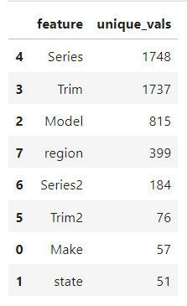
Car Identity & Regional impact on Price
These columns introduced 5,067 new features. TruncatedSVD is used to ‘squash’ the variance of these features into a set number of components
A/B Test to answer:
Do region & state play a role in vehicle prices?
Are certain Makes/Models more/less valuable than the competition within BodyClass?

Slide 33
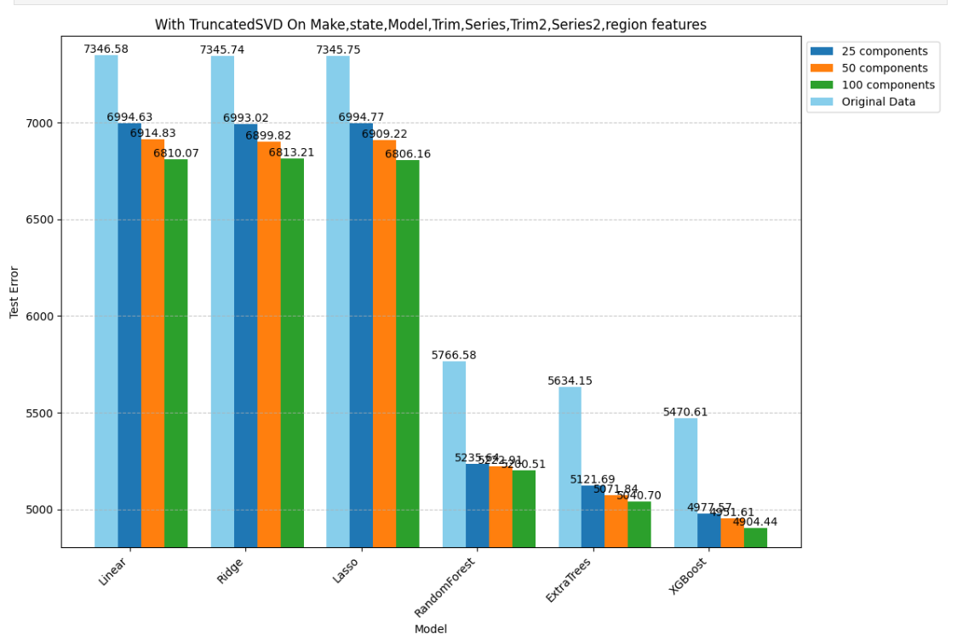

Slide 34
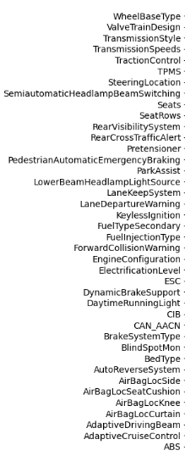
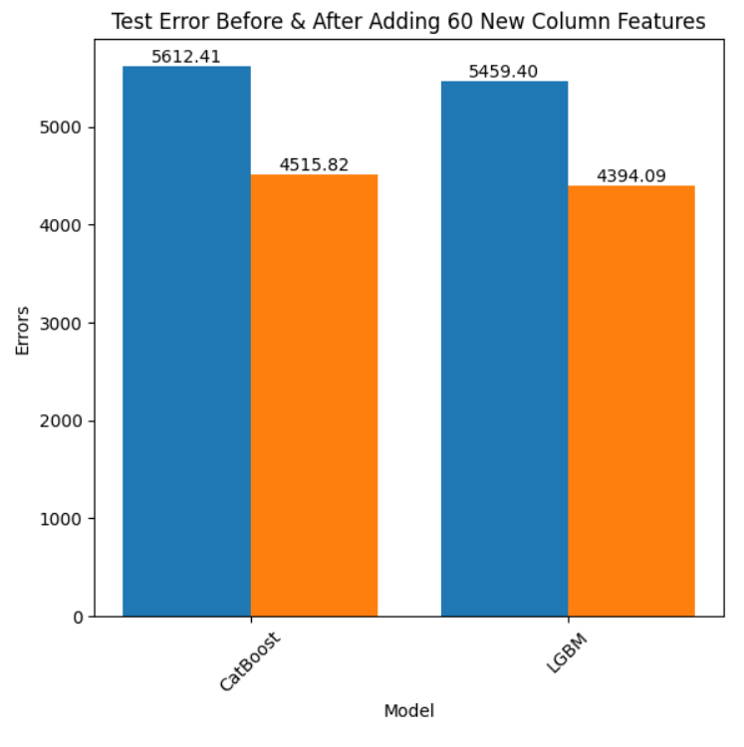

Slide 35
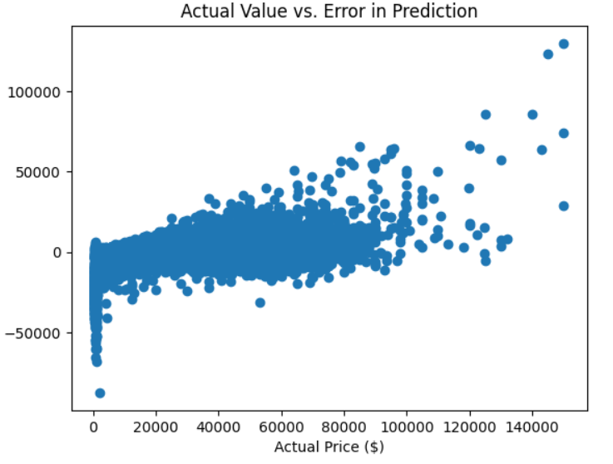
Residual Analysis

Slide 36
Leverage Point #1: Outlier Percentage Error
3 Standard Deviation in % Error: 538 rows
Odometer < 120,000, Year > 2008, & Price < $2500: 708 rows
Overlap: 523 rows

Slide 37
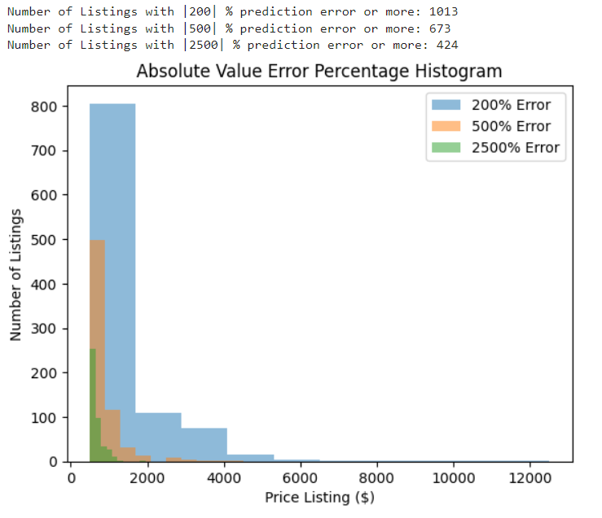
Leverage Point #2:
Absolute Percentage Error

Slide 38


Slide 39
Leverage Point #3: Manual Removal
Manually inspecting the ‘description’ column of the highest percentage errors
4 Large Errors:
Down Payment: ‘$300 Down’
Inoperable Vehicles: ‘For Parts’, ‘As-Is’, ‘Doesn’t Run’, ‘Mechanic Special’
‘Souped Up’ Vehicles: ‘Added {Part} ($600)’
Cargo Vans: Liveable, highly variable; Minority of Dataset

Slide 40


Slide 41


Slide 42
Top 10 Overall Features | Importance
Traction Control: Standard | 0.1523
Rear Visibility System: Standard | 0.0674
Semi Automatic Headlamp Beam Switching: Standard | 0.0522
Body Cab Type: Crew/SuperCrew/CrewMax | 0.0500
ESC: Standard | 0.0401
Body Class: Pickup | 0.0251
Fuel Type Primary: Diesel | 0.0257
Engine Cylinders | 0.0186
Vehicle Type: Truck | 0.0120
Daytime Running Light: Standard | 0.0120

Slide 43
Top 5 Makes | Importance
Porsche | 0.003383
Jeep | 0.002809
Land Rover | 0.002344
Mercedes-Benz | 0.001840
RAM | 0.001834
Top 5 Models | Importance
Porsche 911 | 0.005904
Jeep Wrangler | 0.004085
Acura TLX | 0.003151
GMC Sierra HD | 0.002492
Cadillac XT6 | 0.002194

Slide 44


Depreciation: 2005 Porsche 911
MSRP
Infiniti G35 $30,700
Porsche 911 $83,400

Slide 45


Depreciation: 2007 Jeep Wrangler
MSRP
Wrangler: $22,530
Pathfinder: $27,000

Slide 46


Depreciation: 2015 Acura TLX (V4)
MSRP
Accord EX-L: $28,400
TLX: $31,450

Slide 47


Depreciation: 2015 Acura TLX (V6)
MSRP
TLX: $35,320
RLX: $48,450

Slide 48


Depreciation: 2016 Acura TLX (V6)
MSRP
Accord EX-L: $30,740
TLX: $42,600
RLX: $54,450

Slide 49


Depreciation: 2018 Acura TLX (V4)
MSRP
TLX: $33,000
ILX: $28,100
Clarity: $33,400

Slide 50
Future Work
Data Cleaning: Series/Trim: can be used to obtain new features by…
Data Scraping: Edmunds, KBB
MSRP
Fuel Economy
Horsepower & Torque
Towing Capacity
Safety/Luxury Features
NHTSA API
Crash Ratings, Recalls, Investigations, Complaints
CI/CD Pipeline:
Spam Detection
Automated Data Manipulation: Cleaning up VIN Output, Imputing Missing Values
Time Series Analysis

